Slide 1
Focus on
Volunteering
College Prep
Mr. Gordon
jgordon@bisdtx.org

Slide 2
Upcoming Events
hi

Slide 3
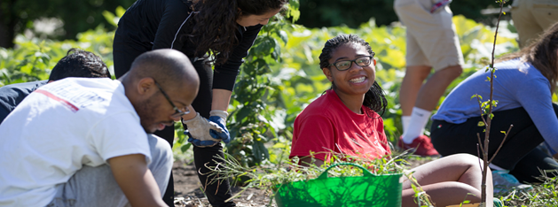
How Many Volunteers Hours Do I Need?
There is no magic number for the amount of community service hours you need.
Most colleges do not require a certain amount of hours, but it may help you get accepted and it certainly expands your college resume/ application.
hi

Slide 4
How Many Volunteers Hours Do I Need?
Many scholarships, however, do require community service hours.
A good goal is 25 hours a year throughout all four years of
high school.
hi

Slide 5
Why Should I Volunteer?
The number, however, is less important than the why.
Ask yourself:
What am I doing?
Why am I doing it?
What am I getting out of it?
If you can effectively answer these questions it will be more important than the number of hours. This is can help with your college essay.
hi

Slide 6
Why Should I Volunteer?
Volunteering can also help you in determining if your future career is right for YOU.
Colleges want to accept people who will change the world.
When applying they want to see that you have
Passion and Commitment.
hi

Slide 7
Where Should I Volunteer?
Many organizations are looking for volunteers, including the Bastrop Library, Bastrop County Animal Shelter, your local church, Bastrop Food Pantry, and the PAC.
You need to log these hours, so you can remember them for college applications.
You can log them in a Google Doc or
get a log sheet from Mr. Gordon.
hi

Slide 8
Today’s College Prep Assignment
In the comments section of today’s College Prep,
answer the following question:
Where do you volunteer?
hi

